Slide 1
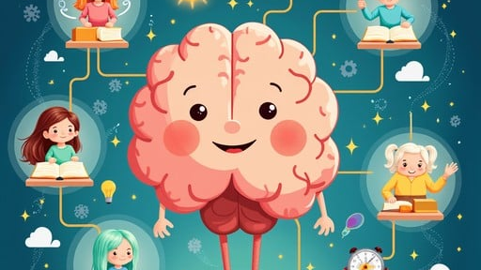
🚀 Created By: Christen Robinson
Deep Learning
Adventure
How AI Learns Like You Do!
Understanding Weights, Bias, and Activation Functions
A Journey into How
Computers Learn to Think!

Slide 2
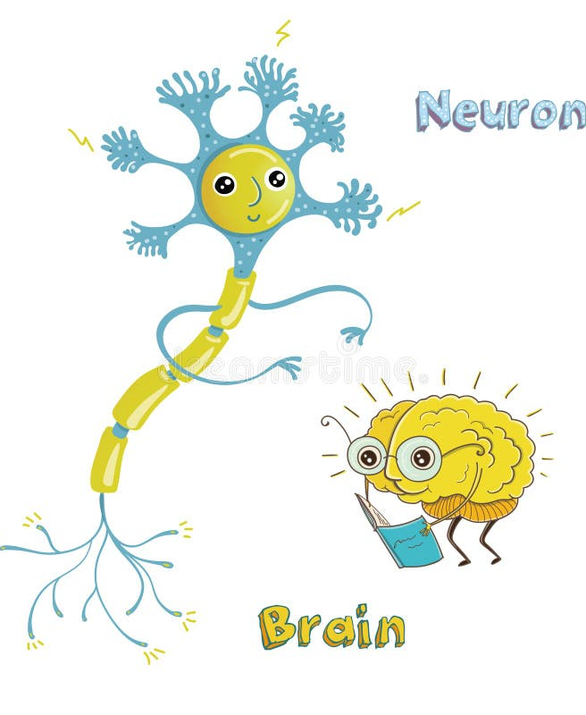
Meet Your Brain - The Ultimate Learning Machine!
86 BILLION Neurons!
Your brain has about 86 billion neurons - that's more than 10 times the number of people on Earth!
These neurons are like tiny messengers that help you:
Learn to ride a bike
Remember birthdays
Recognize your dog's bark
Solve math problems
If your brain can learn, so can computers!
The Cool Part!
Scientists wanted computers to learn like your brain does, so they created "artificial neural networks" - computer brains that copy how YOUR brain works!

Slide 3
The Pizza Party Problem - Introducing Weights
🎭 Story Time
⚖️ WEIGHTS
You're planning the ULTIMATE pizza party for your class. You need to figure out: Will your friends like this pizza?
are like importance scores for each ingredient:
🧀
Cheese
9/10
You Have Clues:
🌶️
Pepperoni
8/10
🧀
Amount of cheese
🍄
Mushrooms
🥦
Vegetables
3/10
lots = yummy!
some friends hate them
🍄
Mushrooms
2/10
🌶️
Pepperoni
🥦
Vegetables
most friends love it!
healthy but... meh
💡 In AI Language:
Weights tell the computer: "Pay LOTS of attention to this!" or "This doesn't matter as much."
Here's the Secret: Not all ingredients matter the same amount!
Real AI Example: When Netflix recommends shows, it uses weights to decide: Does your age matter more? Or what you watched last week? Or what time you usually watch TV?

Slide 4
Weights in Action - The Decision Maker
🧮 Let's Do Math (The Fun Kind!)
This is EXACTLY how AI makes decisions!
Your friend asks: "Will I like this pizza?"
1
Looks at all the information (inputs)
The Pizza has:
2
Multiplies each piece by its weight (importance)
🧀
Cheese: YES (1)
9
3
Adds everything up
× Weight 9
🌶️
Pepperoni: YES (1)
8
4
Makes a prediction!
× Weight 8
🥦
Vegetables: NO (0)
0
× Weight 3
🍄
Mushrooms: NO (0)
0
High score = Your friend will probably love it! 🎉
× Weight 2
Technical Note: In deep learning, weights are numerical values (usually between -1 and 1 or 0 and 1) that are multiplied by input values. During training, the AI adjusts these weights millions of times to make better predictions.
TOTAL SCORE:
9 + 8 + 0 + 0 = 17

Slide 5
Meet Bias - The Starting Line Advantage
🏃 Story Time
⚡ BIAS is like adding extra points BEFORE you start counting!
Imagine a race where some runners get a 10-meter head start . That head start is like BIAS!
Example:
Original score:
+
Bias (hungry):
=
NEW SCORE:
17 points
+5
22 points
🤔 Remember our pizza score of 17?
But what if:
(Even more likely to love the pizza!)
Your friend is REALLY hungry
Bias = +5 points
In AI Terms:
Why Bias Matters:
Your friend just ate lunch
Bias = -3 points
Bias helps the AI make decisions even when the inputs are zero or very small. It's like the AI's "gut feeling" or "starting opinion."
Without bias, if all inputs were zero (no toppings on the pizza), the AI would always say "score = 0" and never make a decision! Bias gives it a starting point.
Your friend is feeling adventurous
Bias = +7 points

Slide 6
Weights + Bias = Learning Superpower
✨ The Magic Formula
This is how AI learns EVERYTHING:
Decision = (Input₁ × Weight₁) + (Input₂ × Weight₂) + (Input₃ × Weight₃) + ... + Bias
Face Recognition
Voice Assistants
Is this Mom or Dad?
What song did they ask for?
Real Example - Will It Rain Today?
Inputs:
• Dark clouds? Yes (1) × Weight 8 = 8
• Wind? Yes (1) × Weight 5 = 5
Video Game Characters
Self-Driving Cars
• Cold? No (0) × Weight 3 = 0
Attack or run?
Stop sign or speed limit?
• Bias (it's been dry all week) = -4
Calculation: 8 + 5 + 0 + (-4) = 9 points
The Learning Part:
Score above 7 = Rain is likely! ☔
When the AI gets it wrong, it adjusts the weights and bias . If it said "no rain" but it DID rain, it increases the weight for "dark clouds" next time!

Slide 7
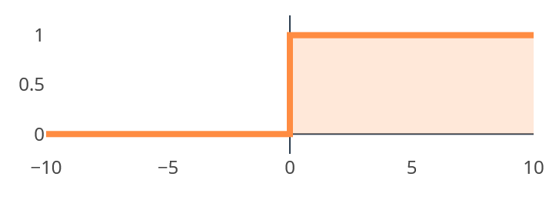

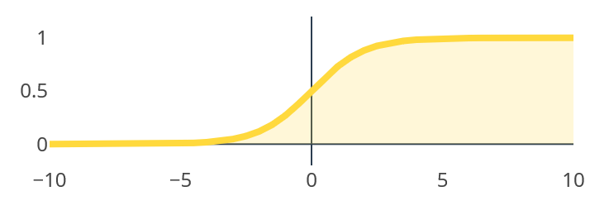
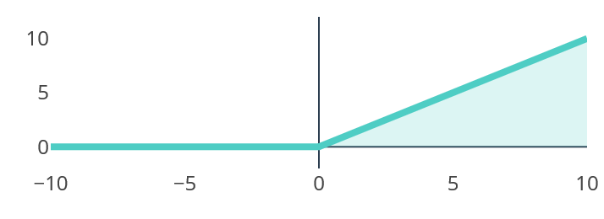
Activation Functions - The Decision Button
🎭 Story Time
📊 Visual Representations
You've calculated your score (17 + 5 = 22 points). But now what? Do you: Definitely order the pizza? or Maybe order it? or Definitely NOT order it?
Step Function
You need a DECISION BUTTON - that's the ACTIVATION FUNCTION!
An activation function looks at your score and decides: "Yes," "No," or "Maybe."
Sigmoid Function
1
Step Function
2
Sigmoid Function
3
ReLU
(Yes or No - No Maybe!)
(The Maybe Button)
(Excitement Meter)
• Score above 15? → YES (1)
• Score = 25 → 95% YES
• Negative score? → 0 (not interested)
• Score below 15? → NO (0)
• Score = 15 → 50% MAYBE
• Score = 5 → 10% NO
• Positive score? → Use that score!
ReLU Function
Like a light switch: ON or OFF
Like a dimmer switch: 0% to 100%
Like your enthusiasm level

Slide 8
Activation Functions in Action
🎯 Scenario: Pizza Score = 22 points
Let's see how each activation function processes this score!
Step Function
Sigmoid Function
ReLU Function
Threshold = 15
Converts 22 into probability
Is 22 positive?
22 > 15?
Yes!
OUTPUT:
OUTPUT:
OUTPUT:
1
0.97
22
(YES!)
(97% certain!)
(Keep score!)
Binary decision:
Smooth decision:
Enthusiasm:
Order it or don't
Very confident yes
Super excited!
Different AI tasks need different activation functions:
Technical Insight:
Image recognition (cat?) → ReLU (fast & accurate)
Modern deep learning mostly uses ReLU because it's computationally efficient and helps AI learn faster. Sigmoid is used in the final layer when we need probabilities.
Probability (rain?) → Sigmoid (gives %)
Simple yes/no (spam?) → Step (quick)

Slide 9
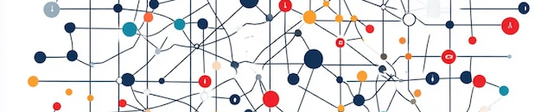
Putting It All Together - A Real Neural Network
🐕 The Complete Picture: Dog or Cat?
Imagine teaching a computer to recognize if a picture shows a DOG or a CAT.
1
INPUTS
2
WEIGHTS
3
CALCULATE
4
ACTIVATION
What the AI sees:
Importance levels:
For "Is it a CAT?" neuron:
Score goes through Sigmoid:
Pointy ears? 1 or 0
Says "meow" → Weight = 9
SUPER important for cat!
Long whiskers? 1 or 0
Wags tail → Weight = 9
(Pointy ears × 4) + (Whiskers × 7) + (Wet nose × 3) + (Meow × 9) + (Wag tail × -8) + Bias
Output =
Wet nose? 1 or 0
SUPER important for dog!
0.92
Says "meow"? 1 or 0
Pointy ears → Weight = 4
Both have them
= Score!
(92% certain it's a CAT!)
Wags tail? 1 or 0
Whiskers → Weight = 7
Cats have longer ones
The Amazing Part:
The AI learns the right weights BY ITSELF! You show it 10,000 pictures of cats and dogs, and it figures out: "Oh! When I see 'meow,' I should make the cat weight REALLY high!"

Slide 10

How AI Learns - The Training Process
🏀 Story: Learning to Shoot Basketball Free Throws
Day 1: You miss (AI gets answer wrong)
• Coach: "Stand closer" (Adjust weights)
• Coach: "Start with ball higher" (Adjust bias)
Day 2: Better! But still missing
• Keep adjusting until you get it right
Day 30: Swish! Perfect shot! (AI trained!)
Guess → Check → Adjust → Repeat
AI learns the EXACT same way:
1
2
GUESS
CHECK
AI makes a prediction with random weights and bias
Did it get the right answer?
Cat → AI said "dog" → WRONG! ❌
3
4
ADJUST
REPEAT
If wrong, adjust weights and bias
Do this MILLIONS of times until the AI gets really good!
Technical Term:
"I gave 'wet nose' too much importance"
This process is called "backpropagation" - the AI works backwards to figure out which weights caused the mistake.

Slide 11
Why All Three Matter - The Team Approach
Think of it like a basketball team:
WEIGHTS
BIAS
ACTIVATION FUNCTION
= The Players' Skills
= The Team Strategy
= The Coach's Decision
• Some players are better at shooting (high weight for scoring)
• "We always play aggressive" (positive bias)
• "Should we shoot now or pass?" (making the final call)
• Some are better at defense (high weight for blocking)
• "We focus on defense first" (negative bias on offense)
• Looks at all the information and decides the action
• Each player has different strengths (different weights)
• Starting game plan before seeing the opponent
• Transforms all that data into a clear decision
The Power of Working Together:
"Alone we can do so little; together we can do so much."
Weights + Bias + Activation Functions = AI that can:
• Beat world champions at chess
• Recognize your face in photos
- Helen Keller
• Translate languages instantly
• Drive cars safely
This applies to AI too! All three components must work together.
• Recommend your next favorite song
• Help doctors find diseases earlier

Slide 12
Real-World Magic - Where You See This Every Day
🎮 Video Games
📱 Your Phone
🎬 Netflix/YouTube
🚗 Self-Driving Cars
🏥 Medical Diagnosis
Enemy AI decides: Attack or defend?
Face ID unlocking your phone
"You might like this video!"
Deciding to stop at red light
Detecting diseases in X-rays
Weights: Eye shape, nose, face oval
Weights: What you watched, how long
Weights: Light color, sign shape, cars
Weights: Dark spots, unusual shapes
Weights: Player health, distance, weapon
Bias: Lighting conditions
Bias: Popular videos get boost
Bias: "Always be cautious"
Bias: Patient age and symptoms
Bias: Difficulty setting
Activation: Is this the owner?
Activation: Probability you'll click
Activation: Brake hard or keep going
Activation: Probability of disease
Activation: Attack now? Yes/No
All around you, AI is using weights, bias, and activation functions to make decisions!

Slide 13
Deep Learning - Layers Upon Layers
Remember one neuron making one decision? Real AI uses THOUSANDS of them in LAYERS!
Neural Network Layers Visualization
How Layers Work:
1
Layer 1: Simple Features
Detects lines, edges, colors. "This has pointy things"
Mind-Blowing Fact:
2
Layer 2: Combinations
GPT-3 (an advanced AI) has 175 BILLION weights! That's like having 175 billion importance scores it adjusts to understand language.
Combines simple features. "Pointy things + furry = Ears!"
3
Layer 3: Objects
Fun Comparison:
Recognizes whole objects. "Ears + whiskers = Cat face!"
Your brain:
86 billion neurons
4
Layer 4: Context
Understands bigger picture. "Cat face + couch = House cat!"
GPT-3:
175 billion parameters
Each layer has its own weights, biases, and activation functions!
GPT-4:
Even more! (secret!)

Slide 14
Key Takeaways - Remember These!
🎯 Weights
⚡ Bias
🚦 Activation Functions
= Importance Scores
= Starting Point
= Decision Makers
• Tell AI what to pay attention to
• Gives AI a "head start" or "default opinion"
• Turns calculations into final answers
• Like deciding which pizza toppings matter most
• Like being hungry before seeing food
• Like deciding: "Yes!" or "Maybe" or "Nope!"
• Can be adjusted and learned
• Helps AI make decisions even with zero inputs
• Different types for different jobs
🧠 Together They Create Intelligence!
Weights + Bias + Activation
Thousands of neurons
Many layers
Deep Learning
= One neuron
= One layer
= Deep Learning
= Modern AI!

Slide 15
The Future - Where Is This Going?
In the Next 5 Years:
When YOU Grow Up:
• AI tutors that adapt to YOUR learning style
• AI might help solve climate change
• Video games with characters that truly understand you
• Create new medicines faster
• AI that helps design better, cleaner energy sources
• Explore space more safely
• Medical AI that predicts health problems earlier
• Make learning easier for everyone
💼 Jobs You Could Have:
AI Ethics Designer
Neural Network Architect
AI Trainer
Robotics Engineer
Making AI fair
Designing AI brains
Teaching AI new skills
Building smart robots
"The best way to predict the future is to invent it."
- Alan Kay
The Best Part: YOU can be part of creating this future! Every great invention started with someone asking "What if...?"

